Slide 1

Titrimetric Methods; Precipitation Titrimetry

Slide 2
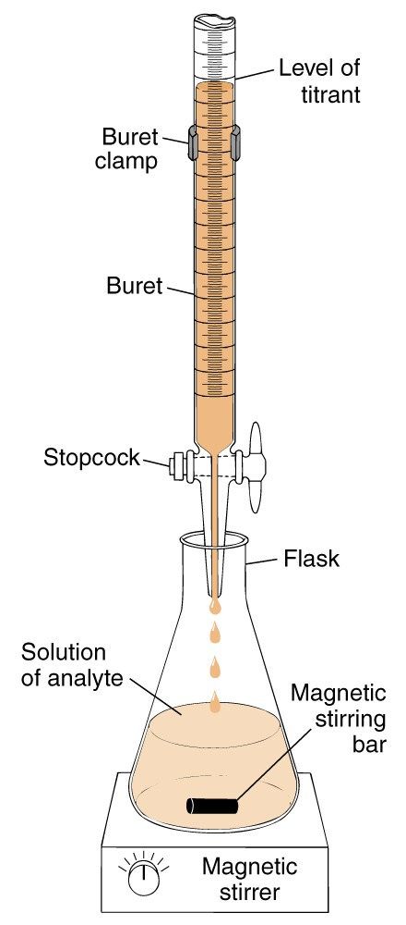
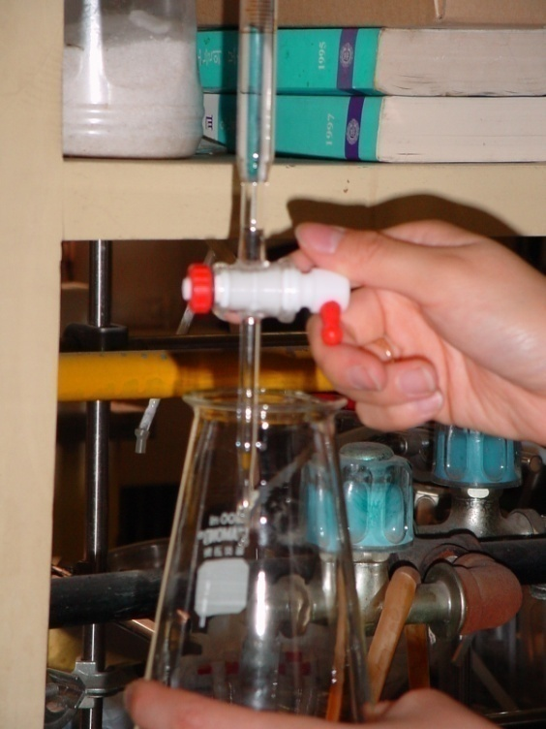
Principles of volumetric analysis
Volumetry : the volume of standard reagent needed to react with analyte is measured
Titrimetry : increments of the titrant are added to the analyte until their reaction is complete.
Titrant vs Analyte
N V = N’V’
N= known
V= measure
N’= unknown
V’= known

Slide 3
Titration :
A procedure for determining the amount of some unknown substance (the analyte ) by quantitative reaction with a measured volume of a solution of precisely known concentration (the titrant ).
Titrant :
The substance that quantitatively reacts with the analyte in a titration . The titrant is usually a standard solution added carefully to the analyte until the reaction is complete. The amount of analyte is calculated from the volume of titrant required for complete reaction.
Indicator :
A substance that undergoes a sharp, easily observable physical change when conditions in its solutions change.

Slide 4
Equivalence point
point in a titration at which amount of titrant is the exact amount necessary for stoichiometric reaction with the analyte.
M,N= known
V= measure
M’,N’= unknown
V’= known

Slide 5
End point : the point in a titration when a physical change occurs that is associated with the condition of chemical equivalence.
The experimental estimate of the equivalence point in a titration
titration error : e_{T} = V_{ep} – V_{eq}
V_{ep} = actual volume at end point,
V_{eq} = theoretical volume of equivalence point
Direct titration : titrant is added to the analyte until the reaction is complete.
Back titration : Adding a known excess of reagent to the analyte, then, a second reagent is used to titrate the excess of the first reagent.
A T₁
Excess T₁ T₂
Ex. PO₄^{3–} + 3Ag⁺ → Ag₃PO₄ (s)
Ag⁺ + SCN – → AgSCN (s)

Slide 6
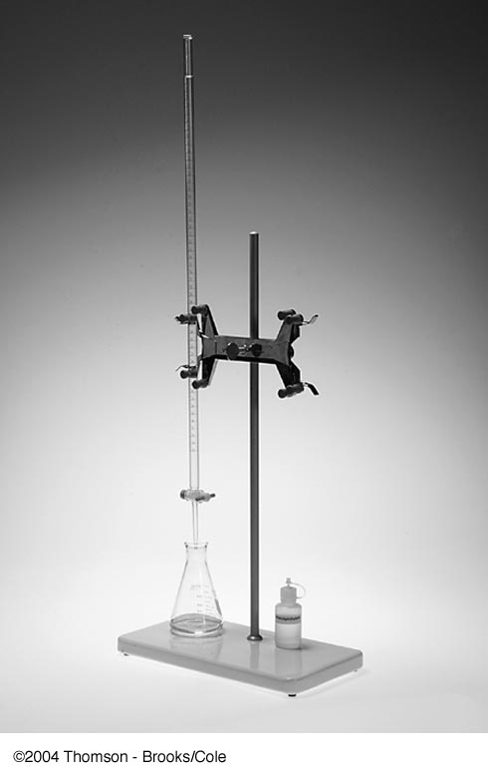
Buret,
buret stand,
clamp,
white porcelain base,
wide-mouth Erlenmeyer flask

Slide 7
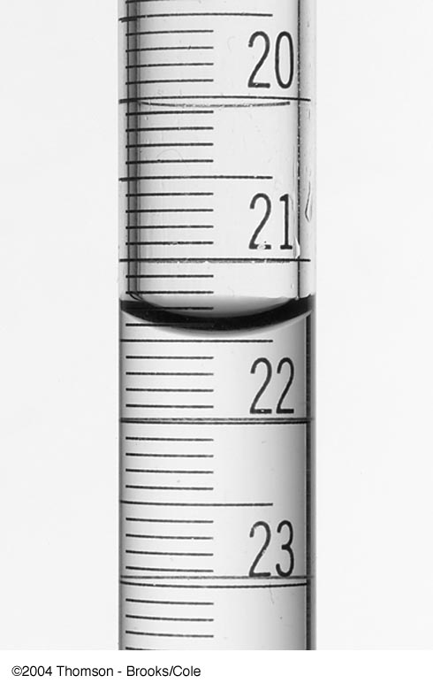
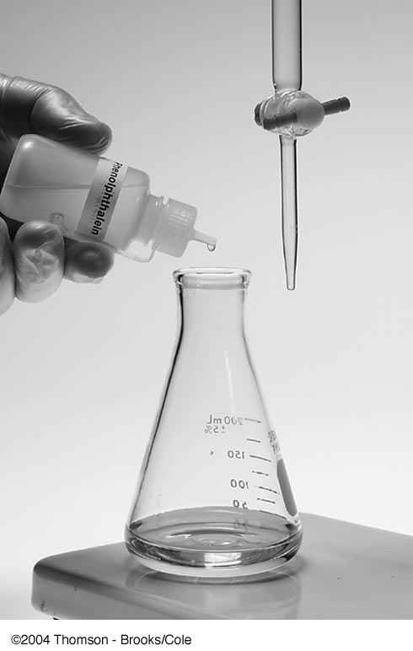
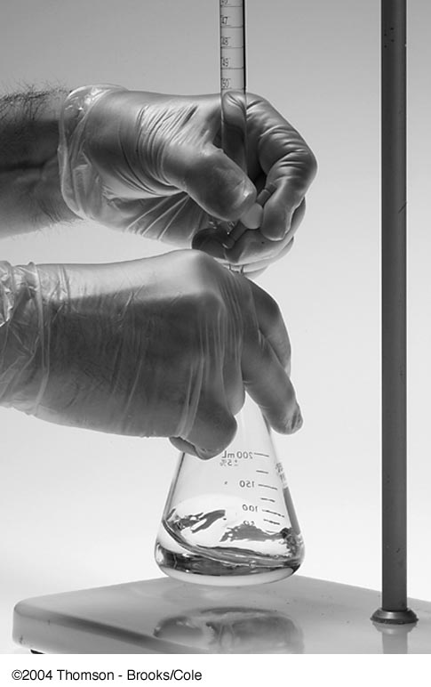
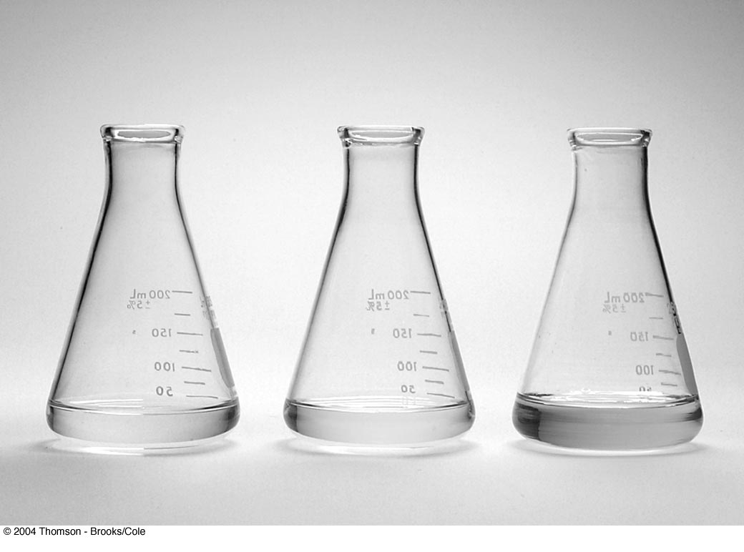
Normally, the buret is filled with titrant solution to within 1 or 2 ml of the zero position at the top. The initial volume of the buret is read to the nearest 0.01 ml.

Slide 8
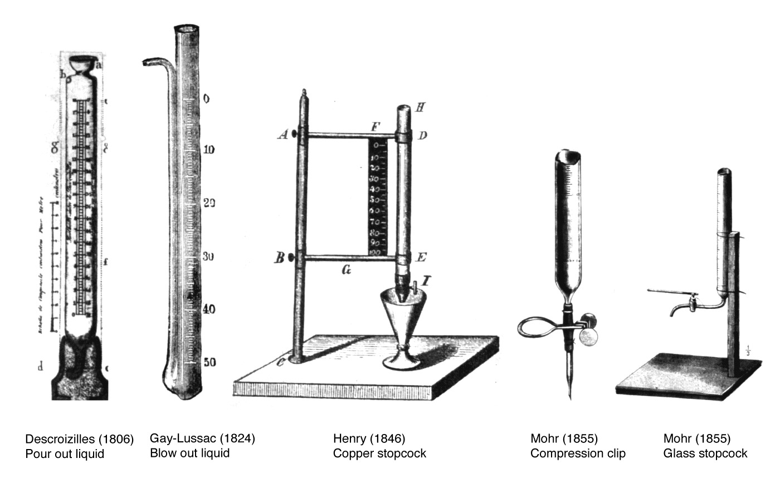
Evolution of the buret

Slide 9
Standard solution :
A solution of precisely known concentration.
Primary standard :
An ultra-pure (99.9% purity) compound that serves as the reference material for a titrimetric method of analysis.
Secondary standard :
A compound whose purity has been established by chemical anallysis and that serves as the reference material for a titrimetric method of analysis
Standardization :
a process in which the concentration of a solution is determined by using the solution to titrate a known amount of another reagent.

Slide 10
Steps in a titrimetry
Weighing 99.9% pure primary standard reagent
xx.xxxx g
Titration other sample solution
Find M’ , N’
V’ ?
N’ ?
Dissolve in a volumetric flask
Buret
Preparation of primary standard solution
Calculation Normality
M,V
Find V’ ml
Beaker
Titration unknown sample solution
Preparation of unknown sample solution
N’,V’
indicator
Transfer pipet
Erlenmeyer Flask V ml

Slide 11
Example
Volumetric determination of chloride in biological fluids (serum, cerebrospinal fluid, or urine)
Titrate with mercuric ion
end point: violet blue complex of Hg²⁺ with Indicator( diphenylcarbazone)
Titration reaction : 2Cl– + Hg²⁺ → HgCl₂ (aq)
Standardization : 2 NaCl ≡ 2Cl– ≡ Hg²⁺
58.443g/L ≡ 35.453g/L ≡ 200.59g/L
Assume that 6.0g NaCl was dissolved in 1 litre and 25 ml of this solution was used to standardize the Hg ²⁺ ion (Hg(NO₃)₂). The volume of Hg(NO₃)₂ at the end point was 28.06 ml
NaCl vs Hg(NO₃)₂
Titration of urine sample : Volume of urine sample: 2 ml
Volume of Hg ²⁺ solution: 22.83 ml

Slide 12
Example : Volumetric determination of calcium in urine
Titration reaction :
Ca²⁺ + (COO)₂^{2–} + H₂O → Ca (COO)₂H₂O (solid)
Ca (COO)₂ + H₂SO₄ → CaSO₄ + H₂(COO)₂
5 H₂(COO)₂ + 2 KMnO₄ +3H₂SO₄ → K₂SO₄+2MnSO₄ +10CO₂ + 8H₂O
purple colorless
Standardization : 5 Na₂(COO)₂ ≡ 2 KMnO₄
134.00 g / L ≡ 2 ×158.004 g / L
Assume 1.5 g Na₂(COO)₂ was dissolved in 1 litre and 10 ml of the solution was used to standardize the KMnO₄ solution. The volume of KMnO₄ solution at the end point was 48.36 ml
Titration of urine sample : volume of urine sample : 5.00 ml
volume of KMnO₄ solution required: 16.17 ml

Slide 13
Kjeldahl nitrogen determination
Digestion (Oxidation):
N(in protein) → NH₄⁺
Distillation of NH₃
NH₄⁺ + OH– → NH₃(g) +H₂O
Collection of NH₃ in excess HCl
NH₃ + H⁺ → NH₄⁺
Titration of unreacted HCl
H⁺ + OH– → H₂O
0.500 ml aliquot of protein
0.02140 M HCl 10.00 ml
0.0198M NaOH 3.26 ml
Protein concentration(mg/ml)?

Slide 14
Solution
0.0198M×3.26ml = 0.02140M×Vml
V= 3.016ml
10.00 ml–3.016ml = 6.984 ml
0.02140M×6.984ml= xM ×0.5ml
x = 0.2989 M
N = 14.0067 g/L = 1M
y mg/0.5ml = 0.2989M y=2.093mg
If N : protein = 16.2 w/w%
∴ protein =2.093×(100/16.2)=12.92mg
∴ protein =12.92mg/0.500ml=25.84mg/ml

Slide 15
Precipitation titration
Precipitation titrations are based on precipitation of the analyte with a precipitant
Precipitation
Precipitation is the conversion of a dissolved substance into insoluble form by chemical or physical means.
Example
Ba²⁺ + SO₄^{2–} → BaSO₄ (white)↓
Detection of end point:
T
End point
Turbidimetry : The intensity of light scattered by particles of precipitate is measured
V(titrant, ml)

Slide 16
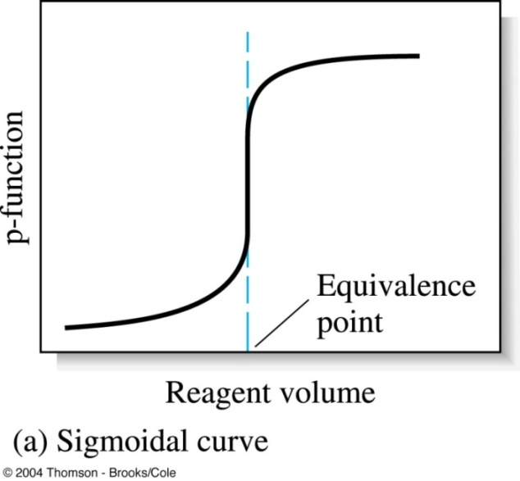
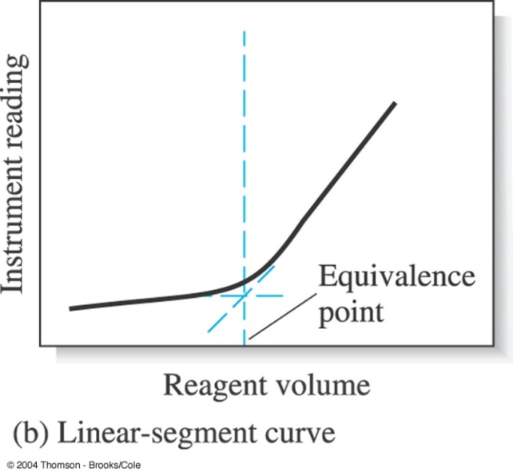
Titration curve
A plot that summarizes data collected in a titration .
Plots of a concentration-related variable as a function of reagent volume.
Linear titration curve plots moles of analyte (or, some quantity proportional to moles of analyte) on the Y axis, and the volume of titrant added on the X axis.
Nonlinear plots use the log of the concentration of the analyte instead. Nonlinear titration curves are often used for neutralization titrations (pH vs. mL NaOH solution).
Logs are used to exaggerate the rate of change of concentration on the plot, so that the endpoint can be determined from the point of maximal slope.

Slide 17
Titration curve
A titration curve provides us with a visual picture of how a property, such as pH, changes as we add titrant
The curve can be measured experimentally by suspending a pH electrode in the solution containing the analyte and monitoring the pH as titrant is added
The curve can also be calculated by considering the reactions responsible for the change in pH
Any titration curve that follows the change in concentration of a species in the titration reaction (plotted logarithmically) as a function of the volume of titrant has the same general sigmoidal shape.

Slide 18
Titration curve
Other parameters, such as temperature or the absorbance of light, may be used if they show a significant change in value at the equivalence point.
Many titration reactions, for example, are exothermic.
As the titrant and analyte react, the temperature of the system steadily increases.
Once the titration is complete, further additions of titrant do not produce an exothermic a response, and the change in temperature levels off.
The titration curve contains two linear segments, the
intersection of which marks the equivalence point.

Slide 19
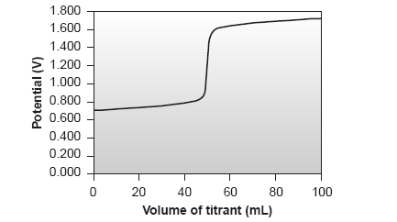
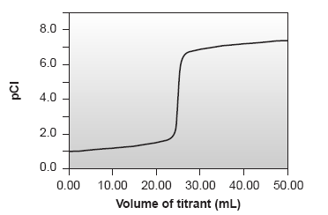
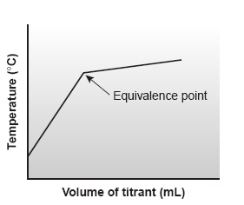
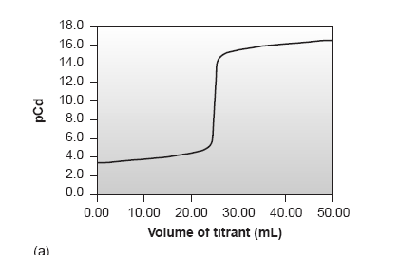

Slide 20
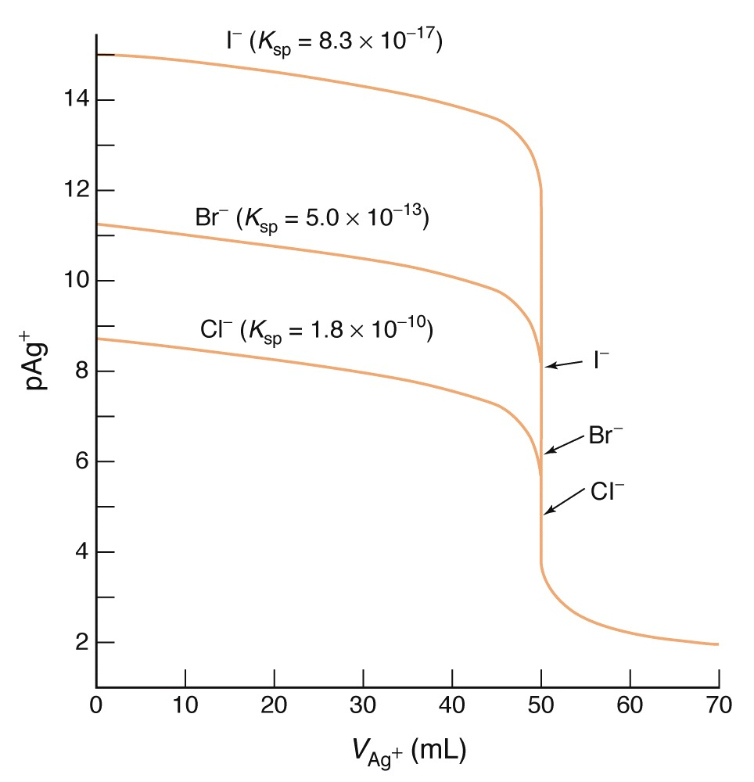
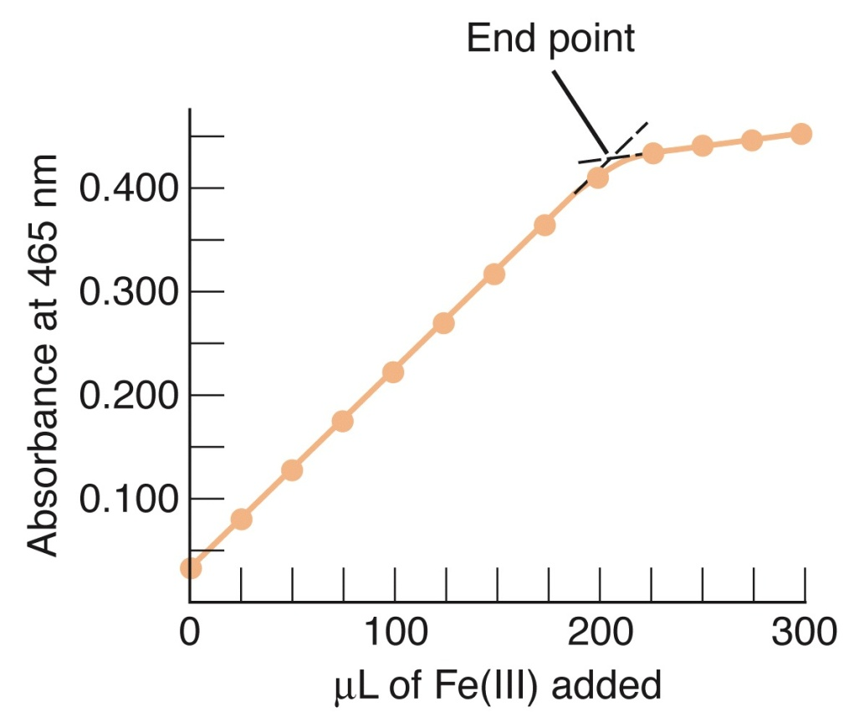
Sigmoidal titration curve
Linear segment titration curve.
Spectrophotometric titration curve of transferrin with ferric nitriloacetate.

Slide 21
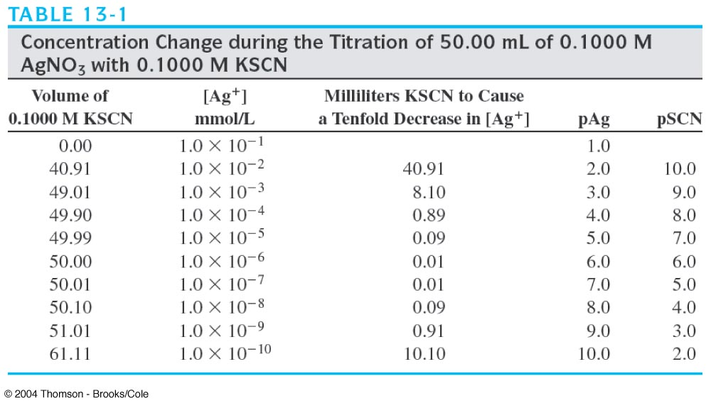

Slide 22
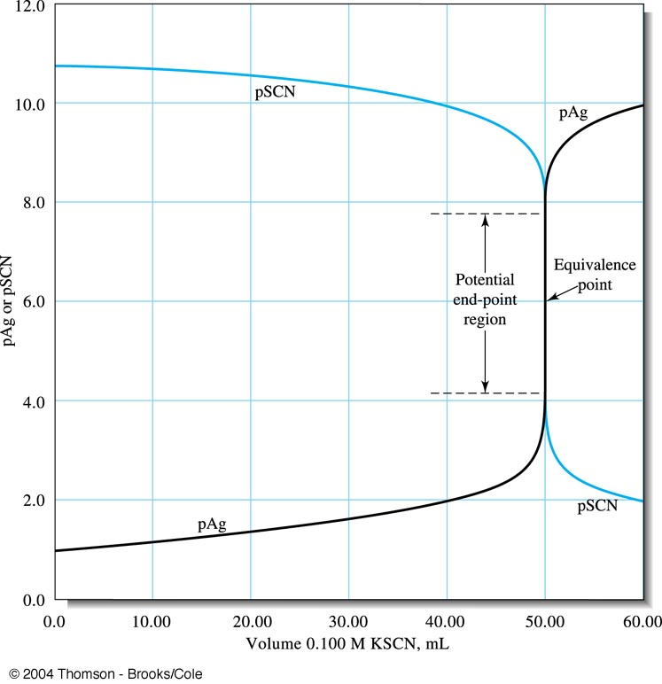
Titration curve for the titration of 50.00 ml of 0.1000M AgNO₃ with 0.1000M KSCN.

Slide 23
Principles of Neutralization Titration

Slide 24
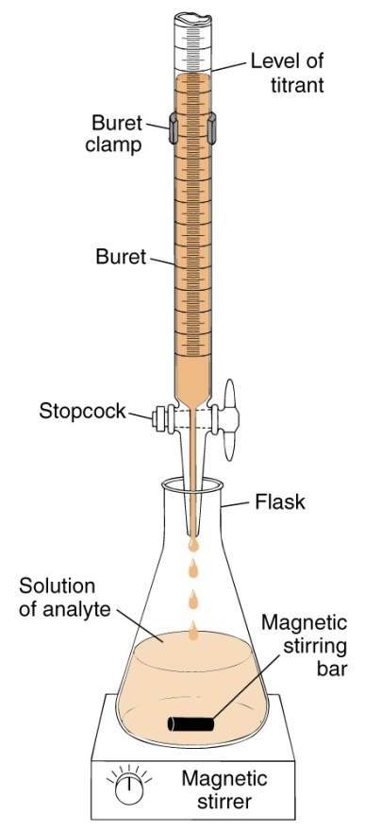
Standard solutions for Acid-Base Titrations
Analyte Titrant vs Standard solution
N V = N’V’
The standard reagents used in acid-base titrations are always strong acids or strong bases, most commonly HCl, HClO₄, H₂SO₄, NaOH, KOH.
Weak acids and bases are never used as standard reagents because they do not react to completion with the analyte.
N= unknown
V= measure
N’= known
V’= known

Slide 25
Primary standards for standardizing
Acids Potassium acid phthalate
Sulfamic acid ( H₂NSO₃H)
HCl
Potassium hydrogen iodate
Bases TRIS(hydroxymethylaminomethane)
Sodium carbonate
Borax (= sodium tetraborate )
HgO

Slide 26
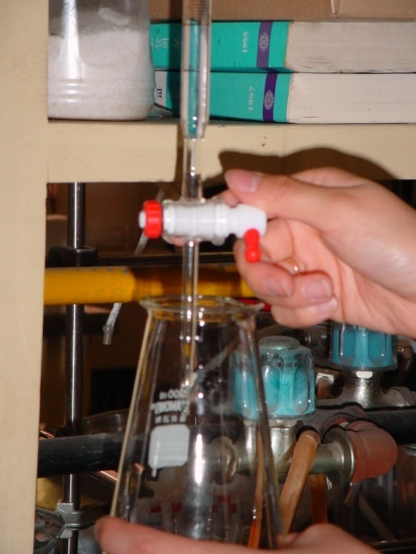
General procedure of acid-base titration
1) Standardization
2) Determination
3) Titration curve
Plots of pH versus volume of titrant
Acid or base
standard solution
unknown molarity(M’)
unknown volume(V’)
Acid or base
standard solution
known molarity(M’)
unknown volume(V’)
Analyte Sample
solution
unknown M_{s}
known V_{s}
4) Interpret titration curve ,
understand what is
happening during titration
Primary standard solution
known molarity(M)
known volume(V)

Slide 27
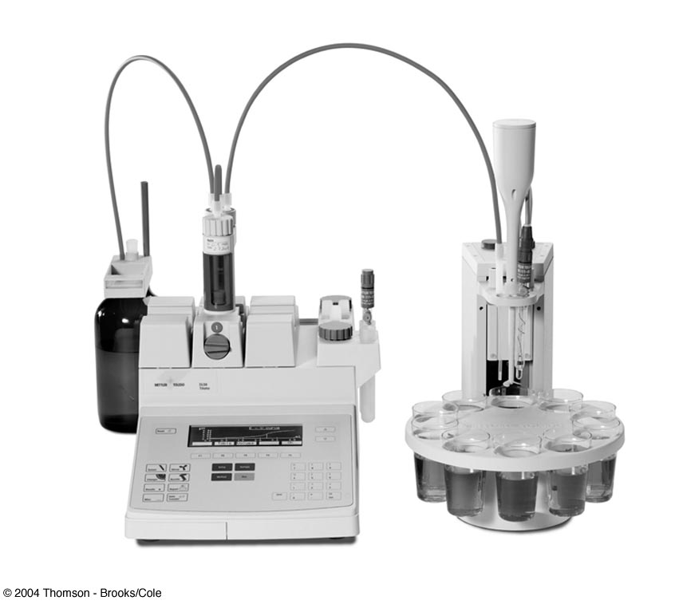
Finding the end point
Indicators
Potentiometer
Conductometry
Spectrometry
Automatic titrator

Slide 28


Indicators
An acid-base indicator is itself a weak acid or base whose different protonated species have different colors.
This change in color can serve as a useful means for determining the end point of a titration, provided that it occurs at the titration’s equivalence point.
The pH at which an acid–base indicator changes color is determined by its acid dissociation constant.
HIn(aq) + H₂O(l) H₃O⁺(aq) + In–(aq)

Slide 29
Indicators
The two forms of the indicator, HIn and In–, have different colors.
The color of a solution containing an indicator continuously changes as the concentration of HIn decreases and the concentration of In– increases.
Assume that both HIn and In– can be detected with equal ease, then the transition between the two colors reaches its midpoint when their concentrations are identical or when the pH is equal to the indicator’s pKa.
The equivalence point and the end point coincide
For such a case, the titration is continued until the indicator’s color is exactly halfway between that for HIn and In–

Slide 30
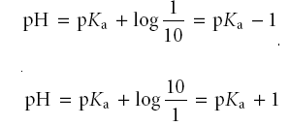
Indicators
Unfortunately, the exact pH at the equivalence point is rarely known
Also, detecting the point where the concentrations of HIn and In– are equal may be difficult if the change in color is subtle
A range of pHs is established over which the average analyst will observe a change in color if we assume that a solution of the indicator is the color of HIn whenever its concentration is ten times more than that of In– , and the color of In– whenever the concentration of HIn is ten times less than that of In–

Slide 31
Indicators
An indicator changes color over a pH range of ±1 units on either side of its pKa
The indicator will be the color of HIn when the pH is less than
pKa – 1, and the color of In– for pHs greater than pKa + 1.
For other indicators both the weak acid and weak base are colored, but one form may be easier to see.
In either case, the pH range is skewed toward those pH levels for which the less colored form of the indicator is present in higher concentration.

Slide 32
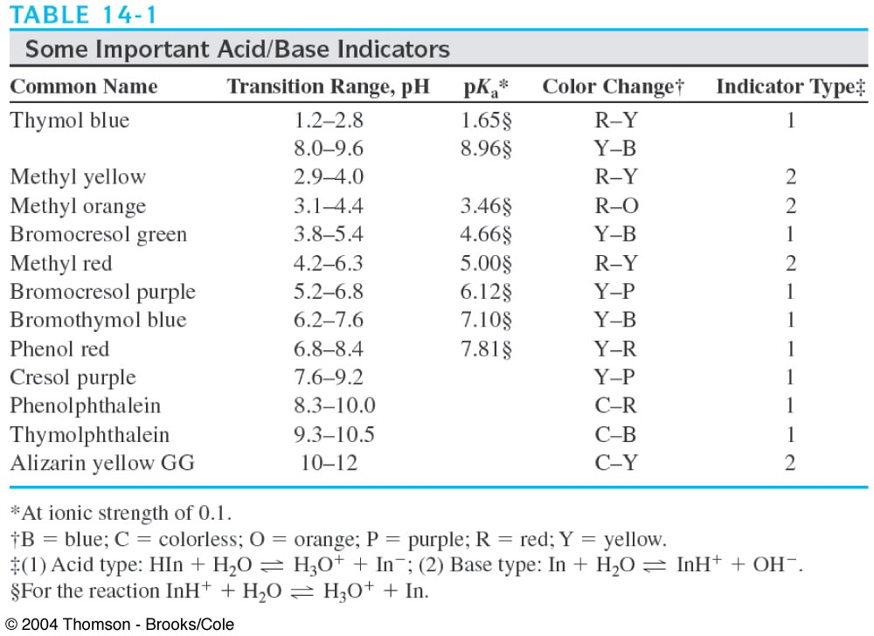
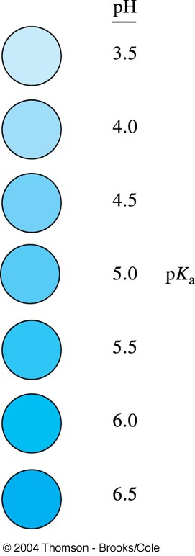
Indicator color as a function of pH (pK_{a}=5.0)

Slide 35
Titrating Strong Acids and Strong Bases
Consider the titration of 50.0 mL of 0.100 M HCl with 0.200 M NaOH
The only equilibrium reaction of importance is
H₃O⁺(aq) + OH–(aq) 2H₂O(l)
To construct the titration curve, calculate the volume of NaOH needed to reach the equivalence point.
At the equivalence point
Moles HCl = moles NaOH
M_{a}V_{a} = M_{b}V_{b}

Slide 36


Strong acid-strong base
The volume of NaOH needed to reach the equivalence point is
Before the equivalence point, HCl is present in excess and the pH is determined by the concentration of excess HCl
Initially the solution is 0.100 M in HCl, which, since HCl is a strong acid, means that the pH is
pH = –log[H₃O⁺] = –log[HCl] = –log(0.100) = 1.00
The equilibrium constant for reaction is (Kw) ^{–1}, or 1.00 x 10¹⁴. For this large value we can assume that the reaction goes to completion. After adding 10.0 mL of NaOH, therefore, the concentration of excess HCl is

Slide 37
Strong acid-strong base
At the equivalence point the moles of HCl and the moles of NaOH are equal.
Since neither the acid nor the base is in excess, the pH is determined by the dissociation of water.
K_{w} = 1.00 x 10^{–14} = [H³O⁺][OH–] = [H₃O⁺]²
[H₃O⁺] = 1.00 x 10^{–7} M
Thus, the pH at the equivalence point is 7.00.

Slide 38
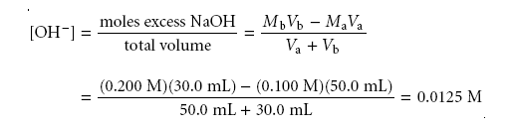
Strong acid-strong base
Finally, for volumes of NaOH greater than the equivalence point volume, the pH is determined by the concentration of excess OH–.
For example, after adding 30.0 mL of titrant the concentration of OH– is

Slide 39

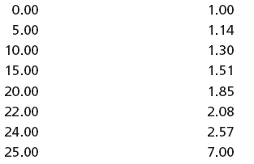
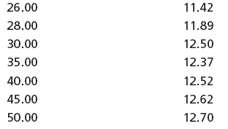
Strong acid-strong base
To find the concentration of H₃O⁺, we use the K_{w} expression

Slide 40

Titrating a Weak Acid with a Strong Base
Consider the titration of 50.0 mL of 0.100 M acetic acid, CH₃COOH, with 0.100 M NaOH.
Calculating the volume of NaOH needed to reach the equivalence point
Moles CH₃COOH = moles NaOH
M_{a}V_{a} = M_{b}V_{b}

Slide 41

Weak Acid - Strong Base
Before adding any NaOH the pH is that for a solution of 0.100 M acetic acid
Since acetic acid is a weak acid, we calculate the pH using the method of K_{a}
CH₃COOH(aq) + H₂O(l) H₃O⁺(aq) + CH₃COO–(aq)

Slide 42

Weak Acid - Strong Base
Adding NaOH converts a portion of the acetic acid to its conjugate base.
CH₃COOH(aq) + OH–(aq) H₂O(l) + CH₃COO–(aq)
Any solution containing comparable amounts of a weak acid, HA, and its conjugate weak base, A–, is a buffer.
The pH can be calculated by using the Henderson–Hasselbalch equation.

Slide 43


Weak Acid - Strong Base
The equilibrium constant for the reaction is large
(K = K_{a}/K_{w} = 1.75 x 10⁹), so the reaction can be considered as going to completion.
Before the equivalence point, the concentration of unreacted acetic acid is
and the concentration of acetate is

Slide 44
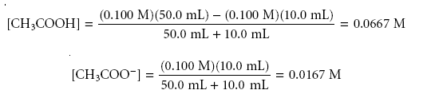

Weak Acid - Strong Base
For example, after adding 10.0 mL of NaOH the concentrations of CH₃COOH and
CH₃COO– are
And

Slide 45

Weak Acid - Strong Base
At the equivalence point, the moles of acetic acid initially present and the moles of NaOH added are identical
Since their reaction effectively proceeds to completion,
the predominate ion in solution is CH₃COO–, which is a weak base. To calculate the pH we first determine the concentration of CH₃COO–.

Slide 46

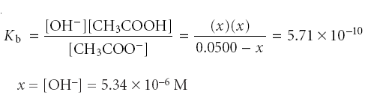
For a weak base
[H₃O⁺] = K_{w} x [OH⁻]⁻¹ = 1.87 X10⁻⁹
pH = 8.73

Slide 47

Weak Acid - Strong Base
After the equivalence point NaOH is present in excess For example, after adding 60.0 mL of NaOH, the concentration of OH– is
pH = 11.96

Slide 48
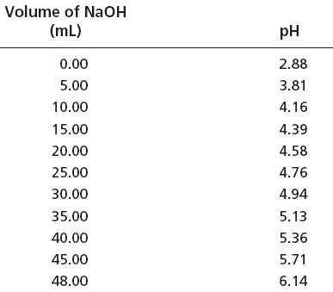
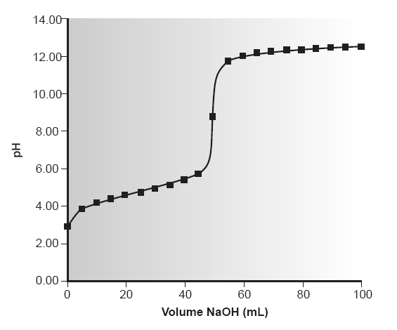

Slide 49
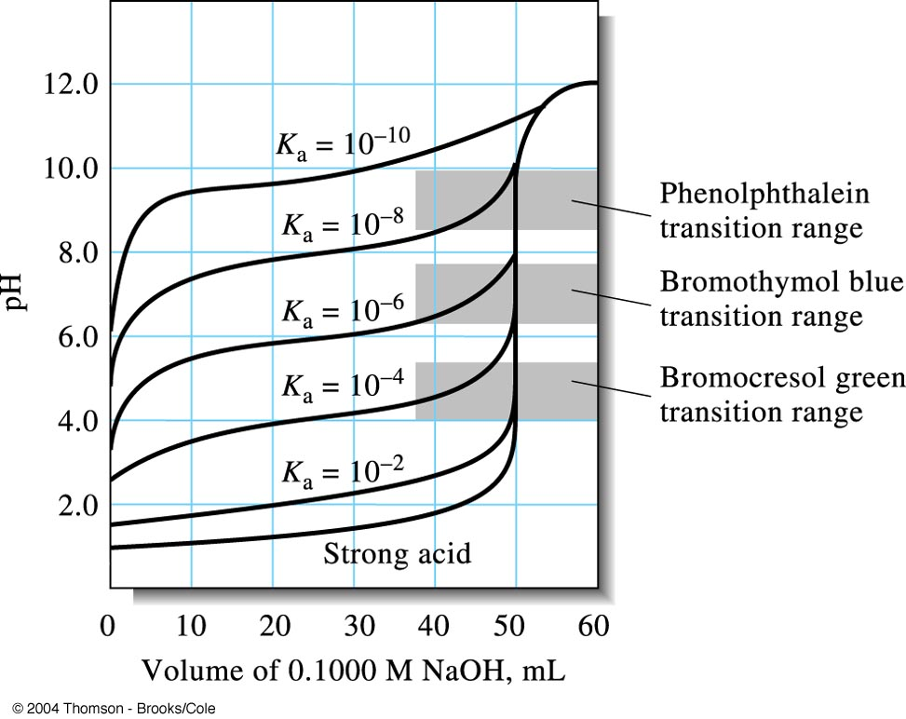
The effect of acid strength on titration curves.
Each curve represents the titration of 50.00 ml of 0.1000 M acid with 0.1000 M base.

Slide 50
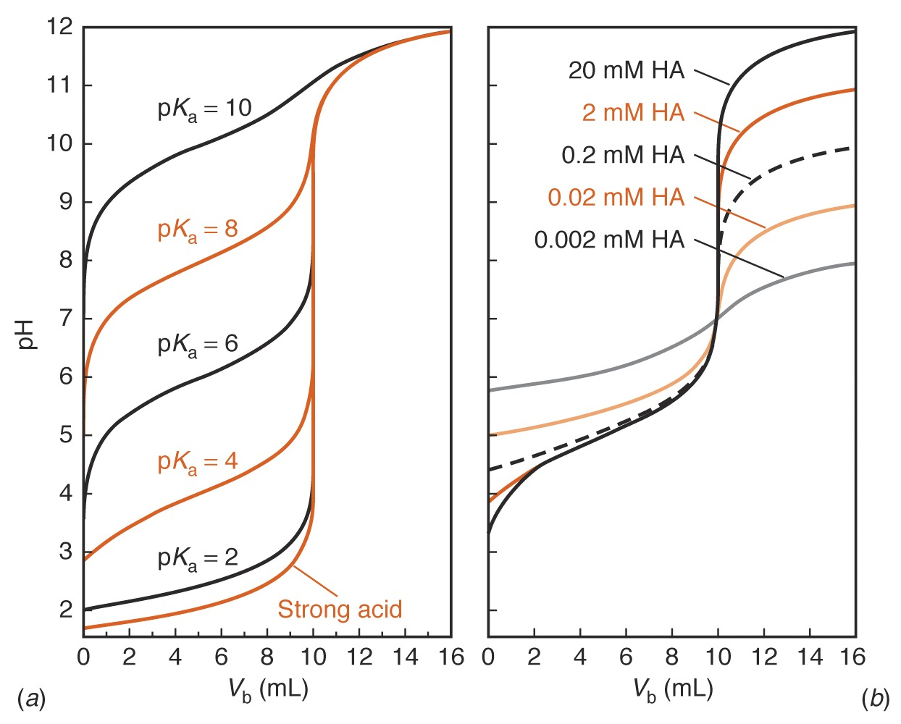
Calculated curves showing the titration of 50.0 mL of 0.0200M HA with 0.100M NaOH.
Calculated curves showing the titration of 50.0 mL of HA with NaOH whose concentration is five times greater than that of HA.

Slide 51
Applications
1. Acidity for the examination of water and wastewater :
Acidity as mg CaCO₃/L ={ N_{NaOH} ×Vml_{NaOH} – N_{H2SO4}× Vml_{H2SO4}}/ Vml_{sample}
2. Titratable acidity in food sample :
% acidity = {N_{NaOH} × Vml_{NaOH} × Eq.wt.(mg/Eq.)_{Acid}}/ Wt(mg)_{sample}
3. Salicylic acid, Benzoic acid, Organic acids
4. Sorensen formol titration : ex. protein hydrolysate ;
the free amino acid is treated with formaldehyde to form the methylimino or methylol derivative, reducing the basicity of the amino group so that the free carboxyl group may be titrated.
R—CH(NH₂)COOH + HCHO = R—CH(NHCH₂OH)COOH
or R—CH(N=CH₂)COOH
5. Kjeldahl nitrogen analysis

